Slide 1
Revelation 3:14-22 ‘The Church in Laodicea’
Rich and Repulsive
Zealous and Submissive

Slide 2
Revelation 3:14-22 ‘The Church in Laodicea’
Rich and Repulsive
Theme: Self-reliance is useless to Jesus

Slide 3
"Perhaps none of the 7 letters is more appropriate to the 20th century church than this. It describes vividly the respectable, sentimental, nominal, skin-deep religiosity which is so widespread today. Our Christianity is flabby and anaemic. We appear to have taken a lukewarm bath of religion. Zeal, heat, fire, passion - these are the qualities we lack today and desperately need."

Slide 4
Revelation 3:14-22 ‘The Church in Laodicea’
Zealous and Submissive
Theme: We need to be a Church that is zealous for, and submissive to Jesus

Slide 5
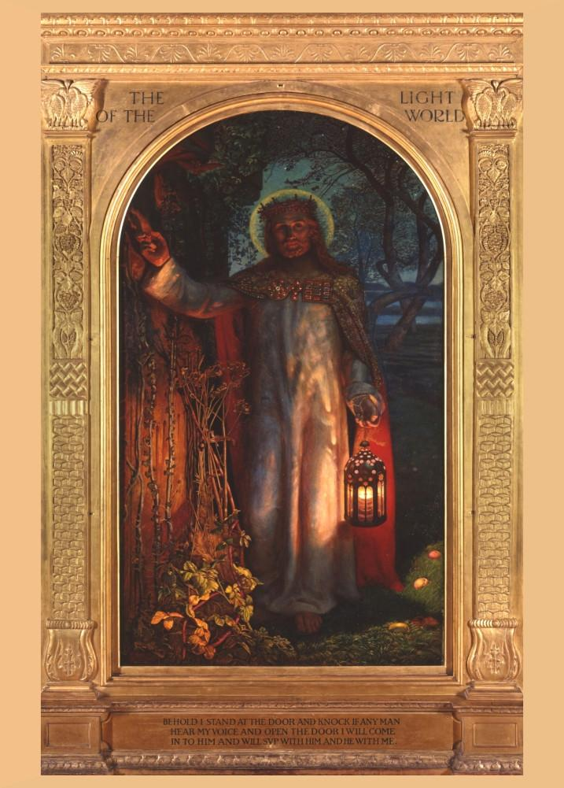

Slide 6
“...Zeal, heat, fire, passion - these are the qualities we lack today and desperately need."

